Slide 1
Functional Simulation ,Synthesis
And Pre Simulation
Using Synopsys Tools
VLSI System Design
CSA & VLSI Lab.
Prof. Kim jin-sang
Jang young-kyu
2010.11.24

Slide 2
Set the target!
For example
Design : FFT_Radix8_4096p_DSP(16bit)
Tool : Synopsys Design compiler , VCS
Library : IDEC-ANAM 0.25um
Design Requirements (For example)
Speed : up to 100MHz
Area : minimum
Power : minimum
ps.
You can find All files for test “/home/your ID/example”
CSA & VLSI Lab.

Slide 3

1. Functional Simulation
Use Cygwin or Xmanager …etc (SSH1 or 2 available Tools)
Login to Worksation : 163.180.118.38
ID / PW : Your student number
Make a Directory for your design
    (ex :[ ID @Sun38 ~]$ mkdir FIR_FILTER)
    make Directorys “Func_sim”, ”Syn”,”Pre_sim” inside Design DIR
    then put in your design with testbench in “Func_sim“ DIR (verilog-HDL )
CSA & VLSI Lab.

Slide 4
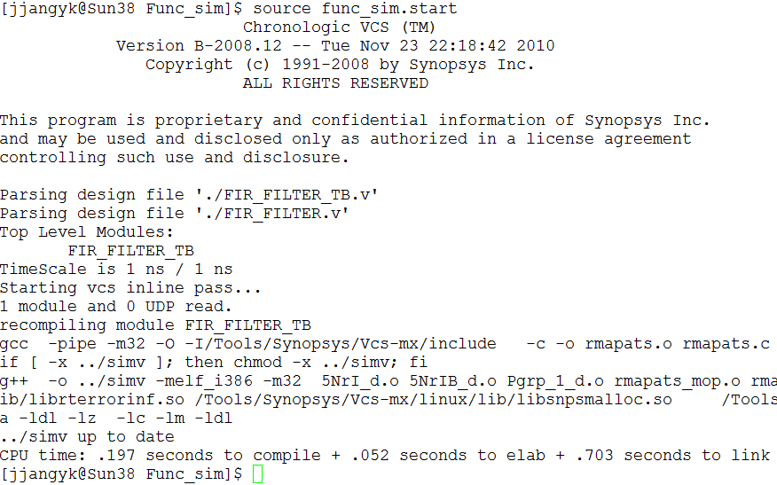
VCS
Now.. Simulate Testbench -> “source func_sim.start”
You have to Confirm “No error” -> “./simv”
CSA & VLSI Lab.

Slide 5
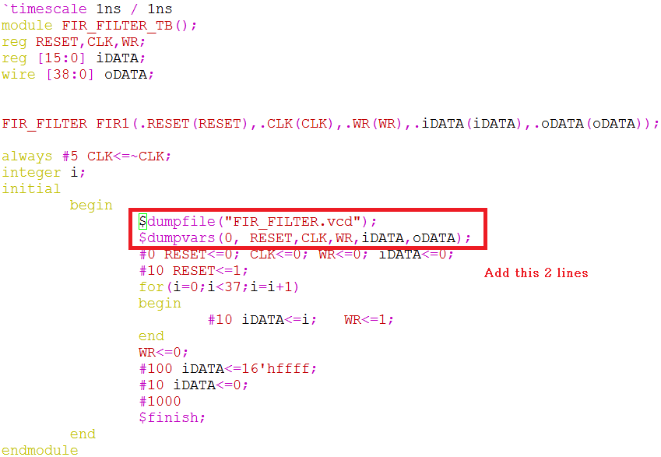

Edit Testbench code for Simulation
Add following lines
$dumpfile(“waveform.vcd”);
$dumpvars(0, signals you want);
And you have to define $finish;
And then make “design_files.f”
Add all your Design files and Testbench Code
CSA & VLSI Lab.

Slide 6
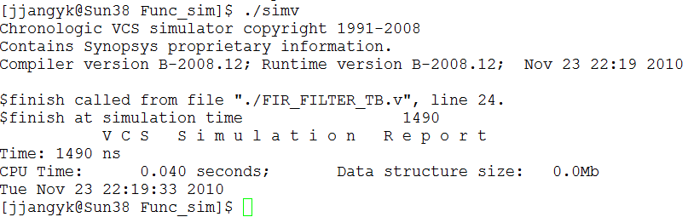
simv
Also You have to Confirm “No error”
And Then “dve &”
CSA & VLSI Lab.

Slide 7
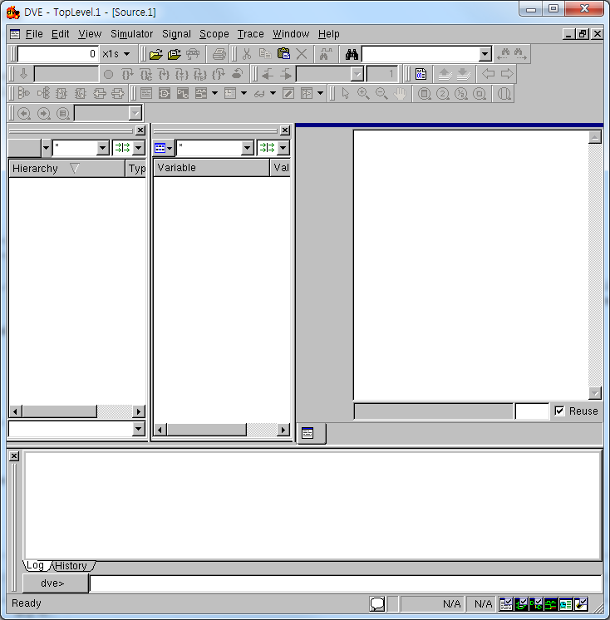
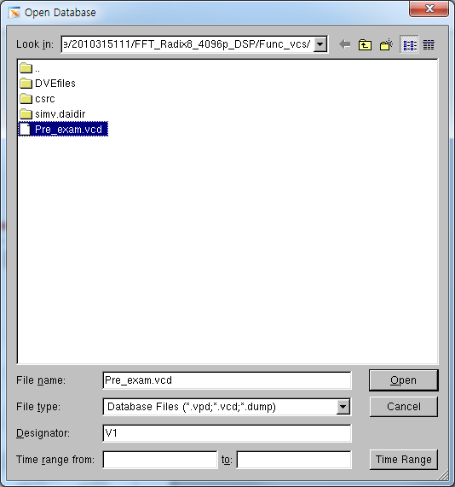
DVE
File->Open Database
Choose “Pre_exam.vcd”
CSA & VLSI Lab.

Slide 8
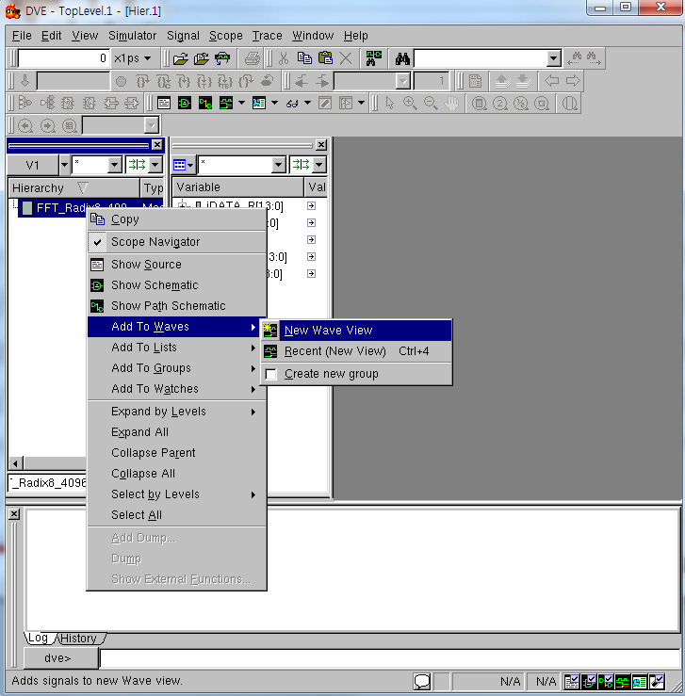
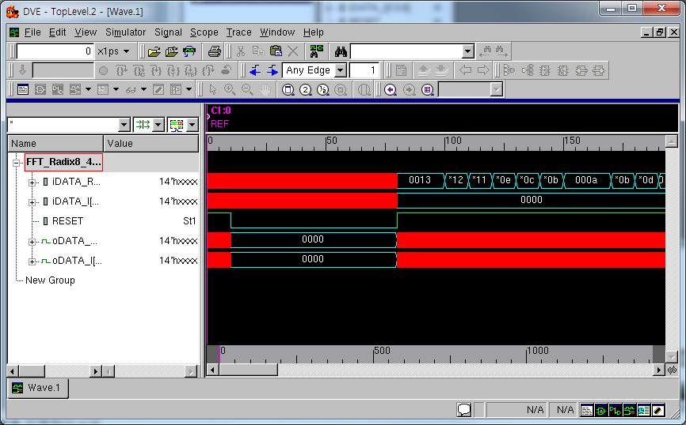
DVE
Right Click
Choose Add to Waves
-> New Wave View
Useful Blind Key
“ f, +, - “
CSA & VLSI Lab.

Slide 9

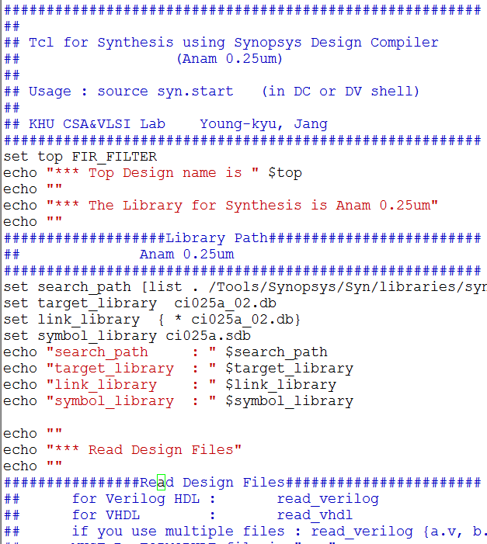
2. Synthesis
Select Design & Edit Constraints
We need “syn.start” file for synthesis and make DIR (output,log) in your “Syn” DIR before synthesis process
Put in your design
Ex) FIR_FILTER.v
then vi syn_anam025.start
Detail information in
Synopsys Synthesis Commands.pdf
Important
clk != CLK
Use same char
CSA & VLSI Lab.

Slide 10
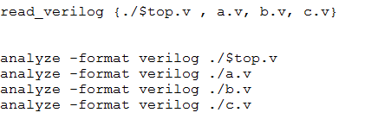
Select Design & Edit Constraints
If you use Hierarchy design, Follow this form
read_verilog {Top_module.v , a.v, b.v, c.v}
Setting another your constraints!
And quit( esc & :wq)
CSA & VLSI Lab.

Slide 11
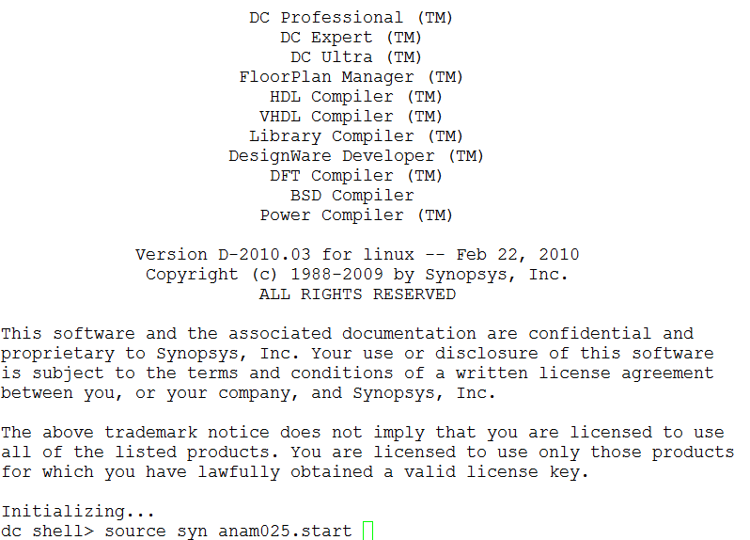
Synthesis
execute ‘dc’ //execute design_compiler
Source syn_anam025.start //execute synthesis
CSA & VLSI Lab.

Slide 12
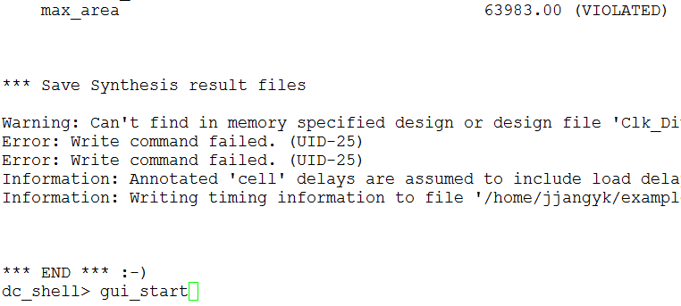
Synthesis result
If You can see any “violated” or any errors in progress
It means fail to satisfy the constraints
Modify your design to pass constraints
In this example , I set constraint of max_area = 0
because I want to make minimum area
But if You can use less than 64,000 then return RTL step, modify your design
We don’t USE over 100,000 Cells Design (we use small chip) in Place n Route(P&R) course!
CSA & VLSI Lab.

Slide 13
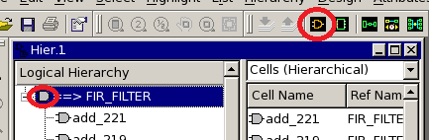
Check Design using Design_Vision
You must check ‘G’ Mark(it means fail or not finished job)
Choose Topname(FIR_FILTER) and click “Create Design Schematic” icon
CSA & VLSI Lab.

Slide 14
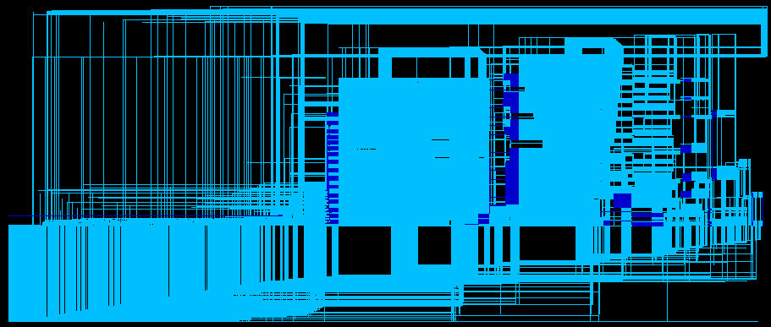
Synthesis finished
You will see like below picture
CSA & VLSI Lab.

Slide 15
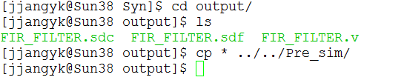
3. Pre simulation
Copy all files of Synthesis result(./Syn/output/*)
to “Pre_sim” DIR
Method of Pre simulation is almost Same that Functional Simulation.
When you Edit Testbench Code for VCS,
Add just 1 line
“$sdf_annotate(“./design_name.sdf”,design_name);
Below the $dumpvars line
CSA & VLSI Lab.

Slide 16
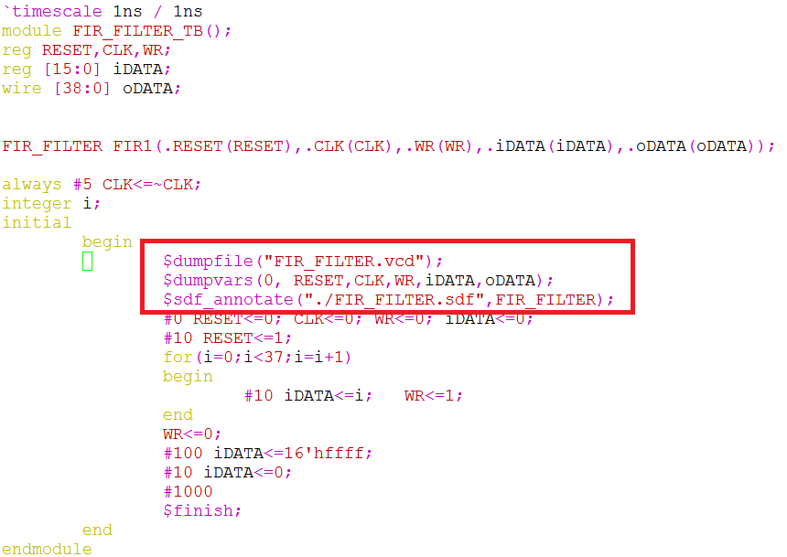
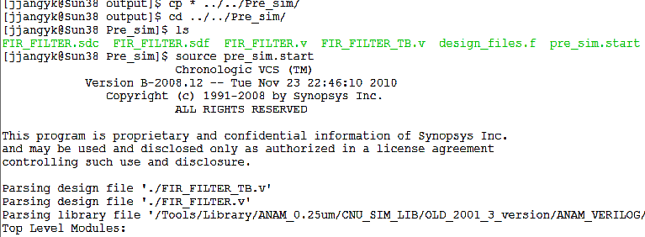
And then
source pre_sim.start
CSA & VLSI Lab.

Slide 17
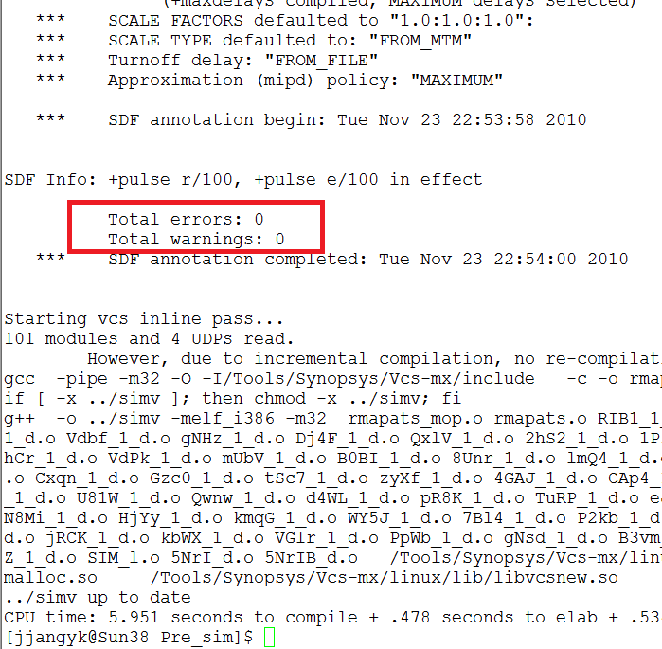
You have to Check “No Error”
After Process is Same ~
./simv
dve &
And Check Waveform
CSA & VLSI Lab.

Slide 18
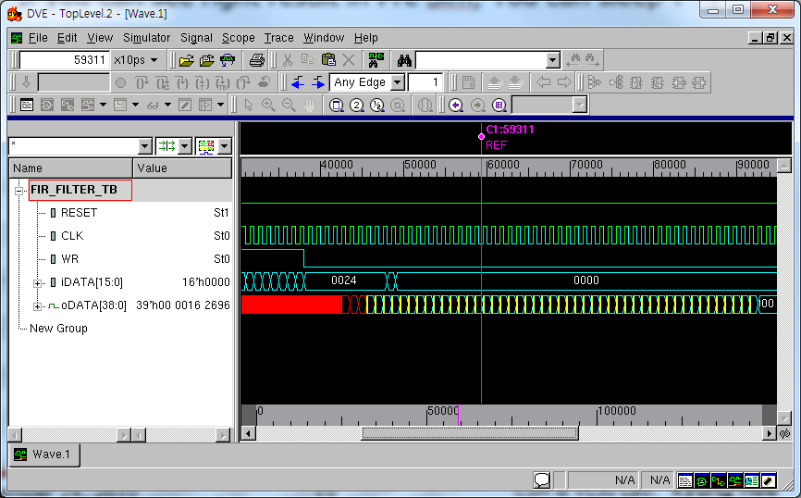
Pre Simulation Result
This is right result of Pre Sim(We can check some delay and glitchs)
CSA & VLSI Lab.

